Slide 1

Motion Modelling Traditional Javanese Dance: Introduction of Javanese Dancer Gesture with 3D Models
Final Project Presentation
Rosyidina Afifah
NRP. 421 0151 013
Wednesday, August 1st 2018
Ir. Dadet Pramadihanto, M.Eng., Ph.D | Artiarini Kusuma Nurindiyani, S.ST., MT

Slide 2
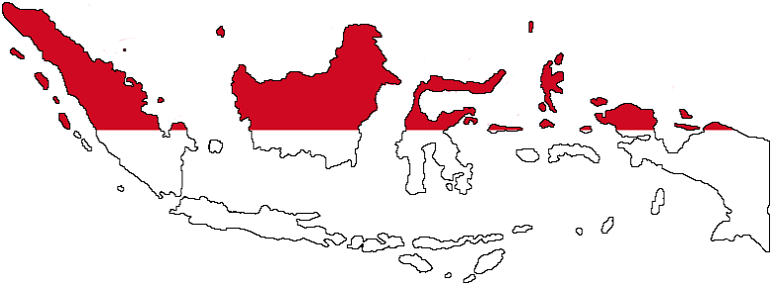
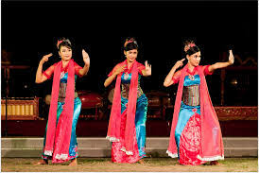
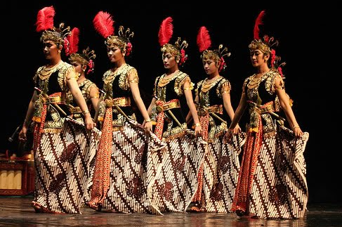
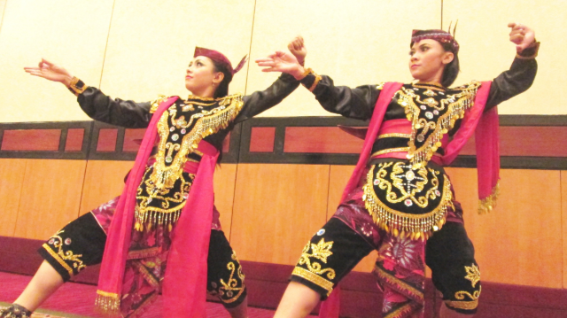
Background (1)
Indonesia has so many kind of culture across the country, especially in traditional dance.
Notes:
Jaipong : jabar
Bedhaya Ketawang from jateng
Remo: jatim

Slide 3

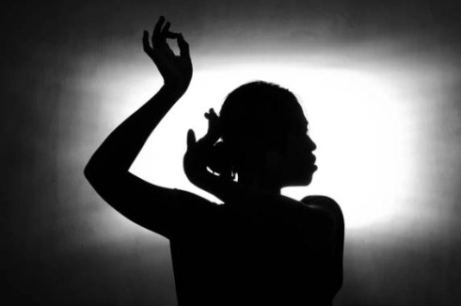
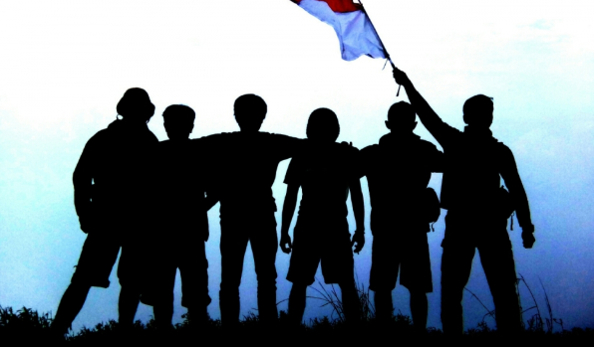

Background (2)
Globalitation effect people knowledge of traditional dance.
Notes:
Following the globalitation era, people are more prefer to learn modern dance instead, making the traditional dance left behind. It makes people’s knowledge about traditional dance became very minimum, especially for the young generation in Java.

Slide 4
Problem
Innovative solution to introduce traditional dance especially for young generation
Notes:
So the young generation can love their own cultural heritance

Slide 5
Objective
Getting results from stop motion, forward, and some other constructive elements for game mechanic.
Create a 3D animated model of the Javanese dancer that matches its movements with the original dancer.
Getting the results of 3D model synchronization analysis with skeleton.

Slide 6
Scope of Problem
Using Javanese Tradional Dance as reference.
Using basic and movement of the dance to get the information of roll, pitch, and yaw rotation.

Slide 7
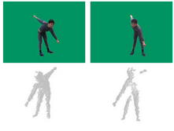
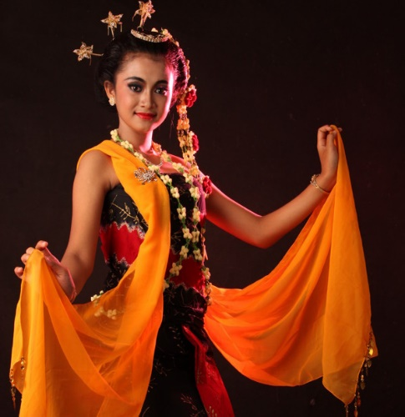
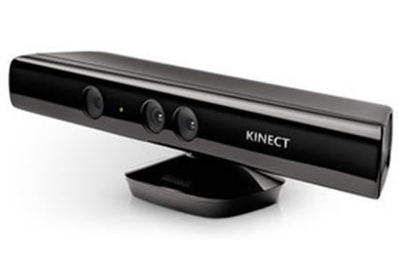
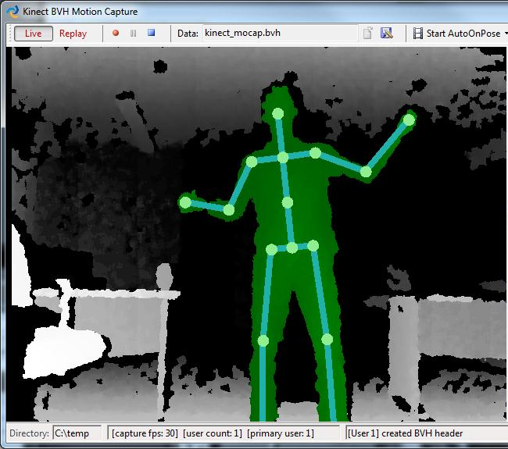
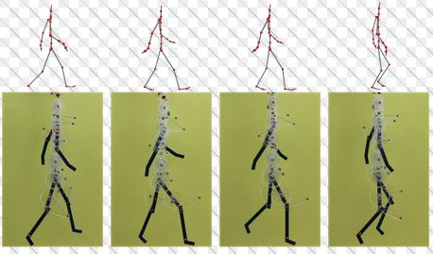
Analized the data
to get the basic movement
Kinect records
the movement
The dancer does movement
of the dance
Create the dance sequence
using re-arranged
basic movement data.
Skeleton’s movement will be
analized to get roll, pitch, yaw
rotation
Diagram System

Slide 8

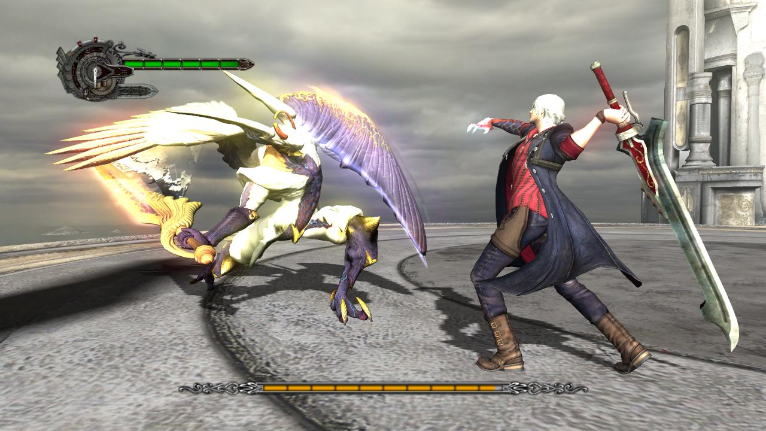
Target Implementation
Media for learning motion
Implementation in game character’s animation
Notes:
*not limited by learning dance, but also sport
*could be implemented in character’s animation for more natural motion

Slide 9
Thank You

